Slide 1


Calculus Videos Project
Calcvids.org
This material is based upon work supported by the National Science Foundation under Awards DUE # 1712312, DUE # 1711837 and DUE # 1710377
Notes:
Slide displays while instructors arrive.

Slide 2
Part 1
Introductions
Background
Watch and Discuss a Video
Overview of Calculus 1 Video Sequence
Foundational Ideas Providing Coherence
Watch and Discuss Another Video
Design Principles
Introduction to the First Video Sequence
More videos revealed
Notes:
This slide is just meant to provide the instructors an outline of what will be happening during Session 1.
1-minute

Slide 3







Meet the Project Team
Aaron
Weinberg
Matt
Thomas
Michael
Tallman
Jason
Martin
Notes:
Project team members who are present, introduce themselves.
Where we are located.
Years experience in math ed research.
Fun fact. :)
Jason: Matt is playing a mandolin (also referred to as a “new york banjo”)
3 minutes max

Slide 4
Introductions: Tell us about yourself.
Where are you from? College/University?
How many years have you been teaching calculus?
Why are you interested in these calculus videos?
How did you learn about these videos?
Notes:
Have each instructor introduce themselves.
5 - 8 minutes

Slide 5


The National Situation in First Semester Calculus
Notes:
Point out that is from a national study funded by the MAA and Bressoud is a former president of the MAA.
1 minute
2013 Paper: https://www.tandfonline.com/doi/abs/10.1080/0020739X.2013.798874
2015 Report: https://www.maa.org/sites/default/files/pdf/cspcc/InsightsandRecommendations.pdf

Slide 6
The National Situation in First Semester Calculus
14,000+ students
213 institutions:
Ph.D. granting in Mathematics
Master’s granting in Mathematics (highest degree)
Undergraduate (Bachelor’s highest mathematics degree)
Two-Year Institutions
502 instructors
Bressoud, Carlson, Mesa, & Rasmussen, (2013); Bressoud, Mesa, & Rasmussen, (2015)
Notes:
Brief Background of MAA study
1 minute
2013 Paper: https://www.tandfonline.com/doi/abs/10.1080/0020739X.2013.798874
2015 Report: https://www.maa.org/sites/default/files/pdf/cspcc/InsightsandRecommendations.pdf

Slide 7
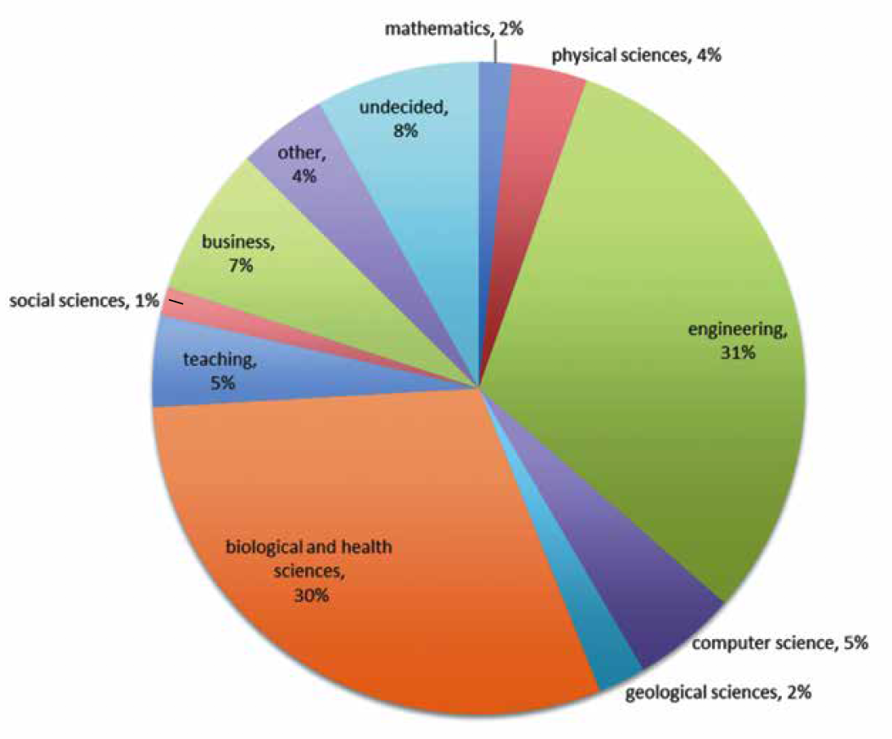
The National Situation in First Semester Calculus
First semester calculus student career goals
Bressoud, Carlson, Mesa, & Rasmussen, (2013); Bressoud, Mesa, & Rasmussen, (2015)
Notes:
Brief Background of MAA study
Every institution is different but your audience tends to NOT be mathematics majors!
1 minute
2013 Paper: https://www.tandfonline.com/doi/abs/10.1080/0020739X.2013.798874
2015 Report: https://www.maa.org/sites/default/files/pdf/cspcc/InsightsandRecommendations.pdf

Slide 8
The National Situation in First Semester Calculus
Student expectations
Going into Calculus 1, what percentage of students expect to earn an A? At least a B?
34% | 43% | 54% | 76%
Bressoud, Carlson, Mesa, & Rasmussen, (2013); Bressoud, Mesa, & Rasmussen, (2015)
Notes:
Interaction Slide - Next slide reveals answers
Have instructors use the table to guess the percentages. Give time for each instructor to at least have a % in mind.
% of students that expect to earn an A?
% of students that expect to earn a B?
1 minute
2013 Paper: https://www.tandfonline.com/doi/abs/10.1080/0020739X.2013.798874
2015 Report: https://www.maa.org/sites/default/files/pdf/cspcc/InsightsandRecommendations.pdf

Slide 9
The National Situation in First Semester Calculus
Student expectations
54% expected to earn an A in their Calculus course
93% expected to earn at least a B
Bressoud, Carlson, Mesa, & Rasmussen, (2013); Bressoud, Mesa, & Rasmussen, (2015)
Notes:
Less than 1 minute
Typically gets a laugh from instructors but can be eye-opening about student expectations.

Slide 10
The National Situation in First Semester Calculus
Reality:
Drop / Fail (≤D) / Withdraw Rate?
18% | 27% | 34% | 39%
Bressoud, Carlson, Mesa, & Rasmussen, (2013); Bressoud, Mesa, & Rasmussen, (2015)
Bressoud, Carlson, Mesa, & Rasmussen, (2013); Bressoud, Mesa, & Rasmussen, (2015)
Notes:
Interaction Slide - Next slide reveals answers
Have instructors use the table to guess DFW rates. Give time for each instructor to at least have a % in mind.
Less than 1 minute

Slide 11
The National Situation in First Semester Calculus
Reality:
27% overall drop-fail(≤D)-withdraw rate
Bressoud, Carlson, Mesa, & Rasmussen, (2013); Bressoud, Mesa, & Rasmussen, (2015)
Notes:
Talk about results. These is based on instructor-reported grades.
Less than 1 minute
Note: The DFW rate can vary greatly. I know of one major university that would not desire to be identify with a DFW rate over 50%.

Slide 12
Leaving STEM
Large Institutional Study, Students Earning a C or Better:
% of students ≥C in Calc 1 & required to take Calc 2 but not persisting? % of students ≥C in Calc 2 & required to take Calc 3 but not persisting?
10% | 20% | 30% | 40%
Seymour & Hewitt, (1997); Thompson et al., (2007)
Notes:
Interaction Slide - Next slide reveals answers
Typically need to explain what “not persist” means.
These are students who reported having a major that required Calc 2 and they passed Calc 1 but they did not (enroll or was it complete) Calc 2?
Questions they may have:
How much time passed? 3-year interval?
Is persit to enroll in or complete?
2 - 3 minutes

Slide 13
Leaving STEM
Large Institutional Study, Students Earning a C or Better:
33% in Calc 1 with major requiring Calc 2 did not persist in Calc 2.
31% in Calc 2 with major requiring Calc 3 did not persist in Calc 3.
Many students were voluntarily leaving STEM because they were unsatisfied with classroom culture.
Seymour & Hewitt, (1997); Thompson et al., (2007)
Notes:
The last bullet is a paraphrase of what both Thompson, et al. and Seymour and Hewitt conclude.
Seymour & Hewitt is a pretty famous book, “Talking About Leaving”
1 minute

Slide 14
Leaving STEM
Large Institutional Study, Students Earning a C or Better:
33% in Calc 1 with major requiring Calc 2 did not persist in Calc 2.
31% in Calc 2 with major requiring Calc 3 did not persist in Calc 3.
Students were voluntarily leaving STEM because they were unsatisfied with classroom culture.
“Most students are not engaged by lecture format” (Bressoud, 2012)
Seymour & Hewitt, (1997); Thompson et al., (2007)
Notes:
The Bressoud quote is from one of the presentations he gave during the early years of the MAA grant and while he was president of the MAA.
Less than 1 minute

Slide 15
The Appeal
Adopt student-centered active learning pedagogies to support student retention and success.
Professional mathematics associations recommending the adoption of active-learning strategies in all math classrooms.
STEM disciplines recommending more problem-solving and in-class activities with small groups.
Braun et al., (2016); Bressoud, Mesa, & Rasmussen, (2015); Freeman et. al, (2014); NAE, (2005); NRC, (2011); & PCAST (2012)
Notes:
Read through.
A transition to the next slide might include a question like, “How do videos play a role in supporting student-centered, active learning pedagogies?”
1 minute

Slide 16
Enter: The Calculus Videos Project (CVP)
Video lessons provide an opportunity for instructors to create more student-centered active classrooms.
Save instructional time
Support flipped and blended instruction
Students are already using videos (e.g. Khan Academy, YouTube)
Videos lessons can provide students the opportunity to engage with the dynamic nature of calculus
Notes:
Read through.
1 minute

Slide 17
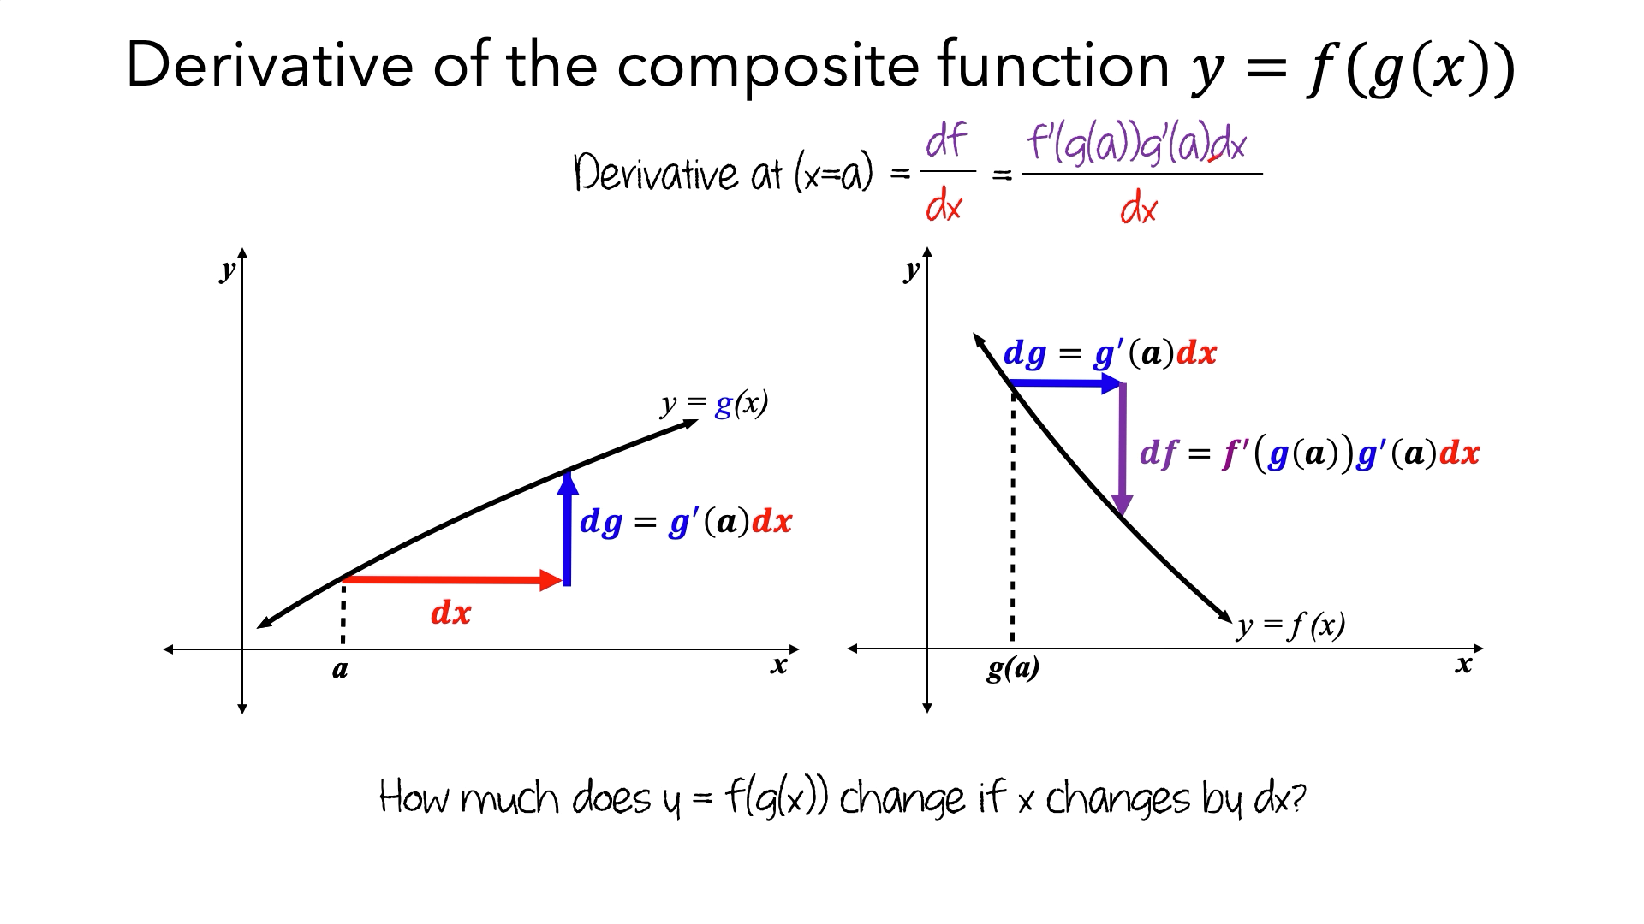
Video: Why the Chain Rule Works
What do you notice?
What do you have questions about?
Notes:
We are going to introduce you to a CVP video.
This particular video is the 3rd video in a set of videos about the Chain Rule. In the first video we attempt to motivate a main idea behind the chain rule using a contextual situation and requesting an average rate of a composite function. The first video concludes with an average rate formula for the composite function consistent with the chain rule. In the second video, the formula for the chain rule is given and multiple problems are worked. In addition, we discuss when the Chain Rule can be applied to a derivative problem and when it is not applicable.
After students have already watched videos motivating the chain rule and on how to use the Chain Rule, this video attempts a more precise answer why the chain rule works.
If there are more than 4-5 participants, discussions will be in breakout room
2-3 minutes

Slide 18
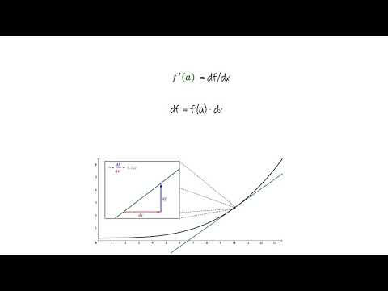
Notes:
“Chain rule - why it works” video
Watch video
5:20

Slide 19
Discussion: Video on Chain Rule
What did you notice?
What do you have questions about?
Notes:
Give instructors time (5 minutes) to discuss questions in breakout rooms.
Report out.
Takes notes on what the instructors report.
After a brief discussion, comment on what that reported that we are going to talk about later.
Address any immediate concerns.
Points for us to make:
Conceptual design principle: How do we represent and discuss quantities?
Prompt students to identify and coordinate measurable attributes (i.e., quantities) as they covary
Represent the relationship between covarying quantities symbolically, graphically, and numerically
Attend to frames of reference and units of measure
Emphasize quantitative (as opposed to arithmetic) operations
Definition of quantity (constructed in the mind of the learner, not inherent in the math)
Measurable attribute of an object or phenomenon
Definition of quantitative reasoning:
Reasoning about quantities, such as conceiving of, relating, etc.
Visual design principles:
Represent amounts of change as lengths of arrows
Use animations to show where things come from
CROC: “Amounts of change in y is essentially f’ times the amount of change in x”
10 minutes

Slide 20
Overview of CVP Videos for Calculus 1
~30 video sets
1-3 videos per set
Video aspects:
Conceptual or Procedural (Session 2)
Real-world context or Mathematical context
Need Inducing videos (Session 2)
https://calcvids.org/vids/
Notes:
Now that you’ve watch a video, let’s give the overall video outline.
Multiple aspects to videos
Take a look at semester overview on calcvids/vids website
1 minute

Slide 21
Sequences of CVP Videos
Three sequences of videos
Rate of Change to Limit Def. of Derivative
Potpourri
Riemann Sums to FTOC
Notes:
Meant to divide up the larger list they just saw into three large chunks.
Less than 1 minute

Slide 22
Sequences of CVP Videos
Three sequences of videos
Rate of Change to Limit Def. of Derivative
Potpourri
Riemann Sums to FTOC
Notes:
We will be showing the first chunk today.
Less than 1 minute

Slide 23
Constant Rate of Change as a Foundation for Ideas
Instantaneous rates of change (derivatives) are defined as limit of average rates of change.
An average rate of change of a function over an interval is the constant rate of change of a linear function (slope of secant line) over the same interval.
When zooming to illustrate derivatives, we observe that for intervals small enough, a differentiable function varies at essentially a constant rate (linear).
Part 2: Riemann sums in context includes imagining a varying rate as if it is constant over successive small intervals.
Notes:
Go over each. Could use speed as an example: Imagine a car speeding up over an interval of time. The average rate of the car is the constant rate that another vehicle would need to cover the same distance in the same time.
Average rate is essential for characterizing phenomena involving non-constant rate.
In addition: understanding constant rate is propitious for supporting students’ conceptual understanding of linear approximation, the chain rule, Riemann sums, Euler’s method, and the Fundamental Theorem of Calculus. What you’ll notice is that we’ll repeat imagery seen in constant rate of change over and over again for the development of these ideas in subsequent videos.

Slide 24
Constant Rate of Change as a Foundation for Ideas
A mature understanding of rate relies upon developed images of continuous variation that include two quantities and how they covary.
Quantity: Measurable attribute of an object (more later)
Speed: Distance & Time
Container: Volume and Height
Etc.
Rate: Defines a proportional relationship between varying quantities’ measures.
Notes:
We take developing of these images very seriously from constant rate of change to the derivative definition.
We choose illustrations that demonstrate invariant relationship of rate. We next demonstrate how we walk through the conceptual development of rate.

Slide 25

A Conceptual Development of Constant Rate
In what ways does this animation demonstrate these ideas?
First: A student must conceive the continuous variation of each quantity.
Rate of change is constant if changes in quantities measure are proportional.
Quantities’ measures require attention to point of reference.
If the variance of f with respect to x is the constant rate m, then the amount of change of f is m times as much as the amount of change in x.
Notes:
Before playing video:
Go over the bullets,
You can ask, in what ways does this video demonstrate the ideas from these bullets?
After video plays: Discussion: Pay close attention to their language.
They need to talk about “lengths of” the blue and red segments
They should compare “lengths” (i.e. length of red segment is ALWAY about ½ the length of the blue segment.
Observe how the red and blue segments are separated out at the bottom.
Talk about how the representation at the bottom might be advantageous. How the graph might be advantageous.
Why the video switched the “initial” point.
What is advantageous about the animation?
Might need to remind them that proportional implies invariant.
Up to 10 minutes?

Slide 26
A Conceptual Development of Derivative
In what ways does this animation demonstrate these ideas?
Leverage constant rate of change.
Derivative as limit of average rates.
For intervals small enough, a function varies at essentially a constant rate.
Over small enough intervals, the amount of change in f is f ’(a) times as much as as the change in x.
Notes:
Before playing video:
Go over the bullets,
Then tell them to pay attention to the questions as they watch.
After video plays: Discussion: Pay close attention to their language.
They need to again use “length” as they talk.
Talk about how this image leverages what they saw with CROC.
Focus to the bottom right image after the zoom.
Related: You can talk about how the sentence structure is repeated between CROC and here: :”the amount of change of f is m times as much the amount of change in x” but here m is f prime.
Talk about why the change to dx.
Up to 10 minutes?

Slide 27
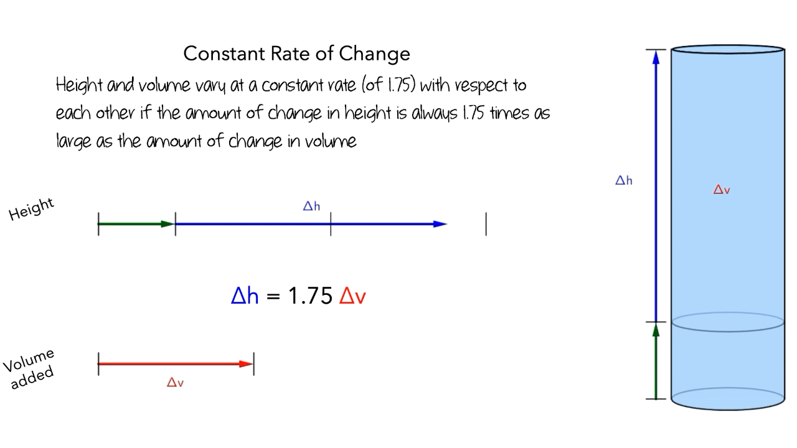
Video: Constant Rate of Change (CROC)
Definition of CROC
Representations of CROC
How might CROC relate to (other) calculus ideas?
Notes:
This our first video in our first video set. This video set focuses on constant rate of change in context.
Think about definition of CROC
Representations of CROC
How this idea might appear in other calculus concepts
What you are about to watch might not feel much like calculus. You are about to see a representation of a contextual problem involving pouring water.
You are not going to see a graph. In fact, graphing is reserved until the next video set?
2 minutes

Slide 28
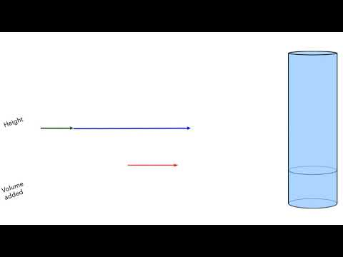
Notes:
5:09

Slide 29
Discussion: CROC
What did you notice?
Questions?
Discuss:
Definition of CROC
Representations of CROC
How might CROC relate to (other) calculus ideas?
Notes:
5 minute breakout
Have instructors report out.
Takes notes on what the instructors report.
After a brief discussion, comment on what that reported that we are going to talk about later.
Address any immediate concerns.
10 minutes total

Slide 30
Representations of Measurable Attributes
Notes:
5 minutes
[use image(s) from Pouring Water to highlight labeling, and how quantities are represented
Show a clip where the quantities are depicted horizontally and then transition to a graph.
More on quantities will be discussed later.

Slide 31
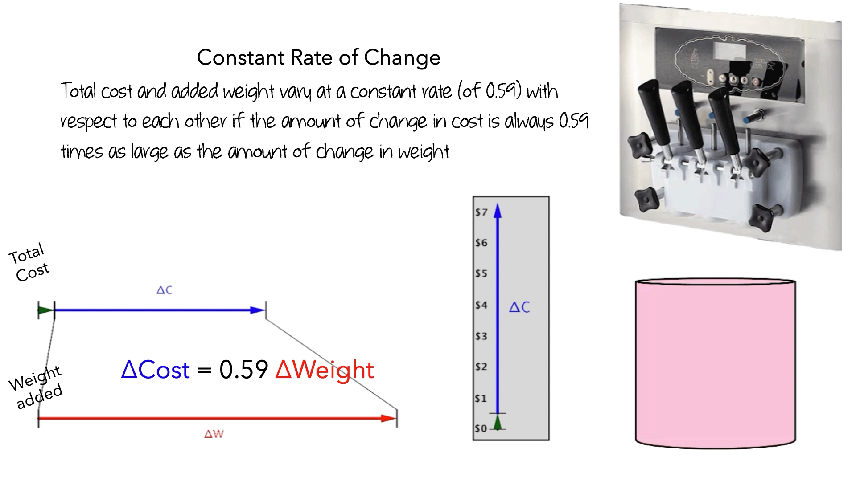
Representations of Measurable Attributes
Notes:
5 minutes

Slide 32
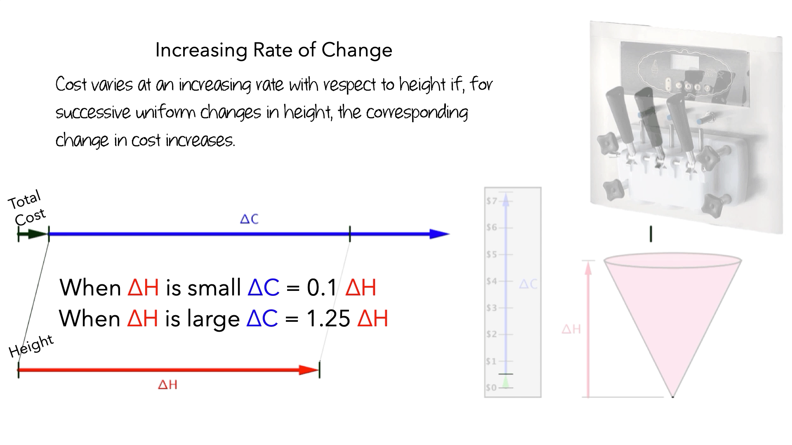
Representations of Measurable Attributes
Notes:
5 minutes

Slide 33
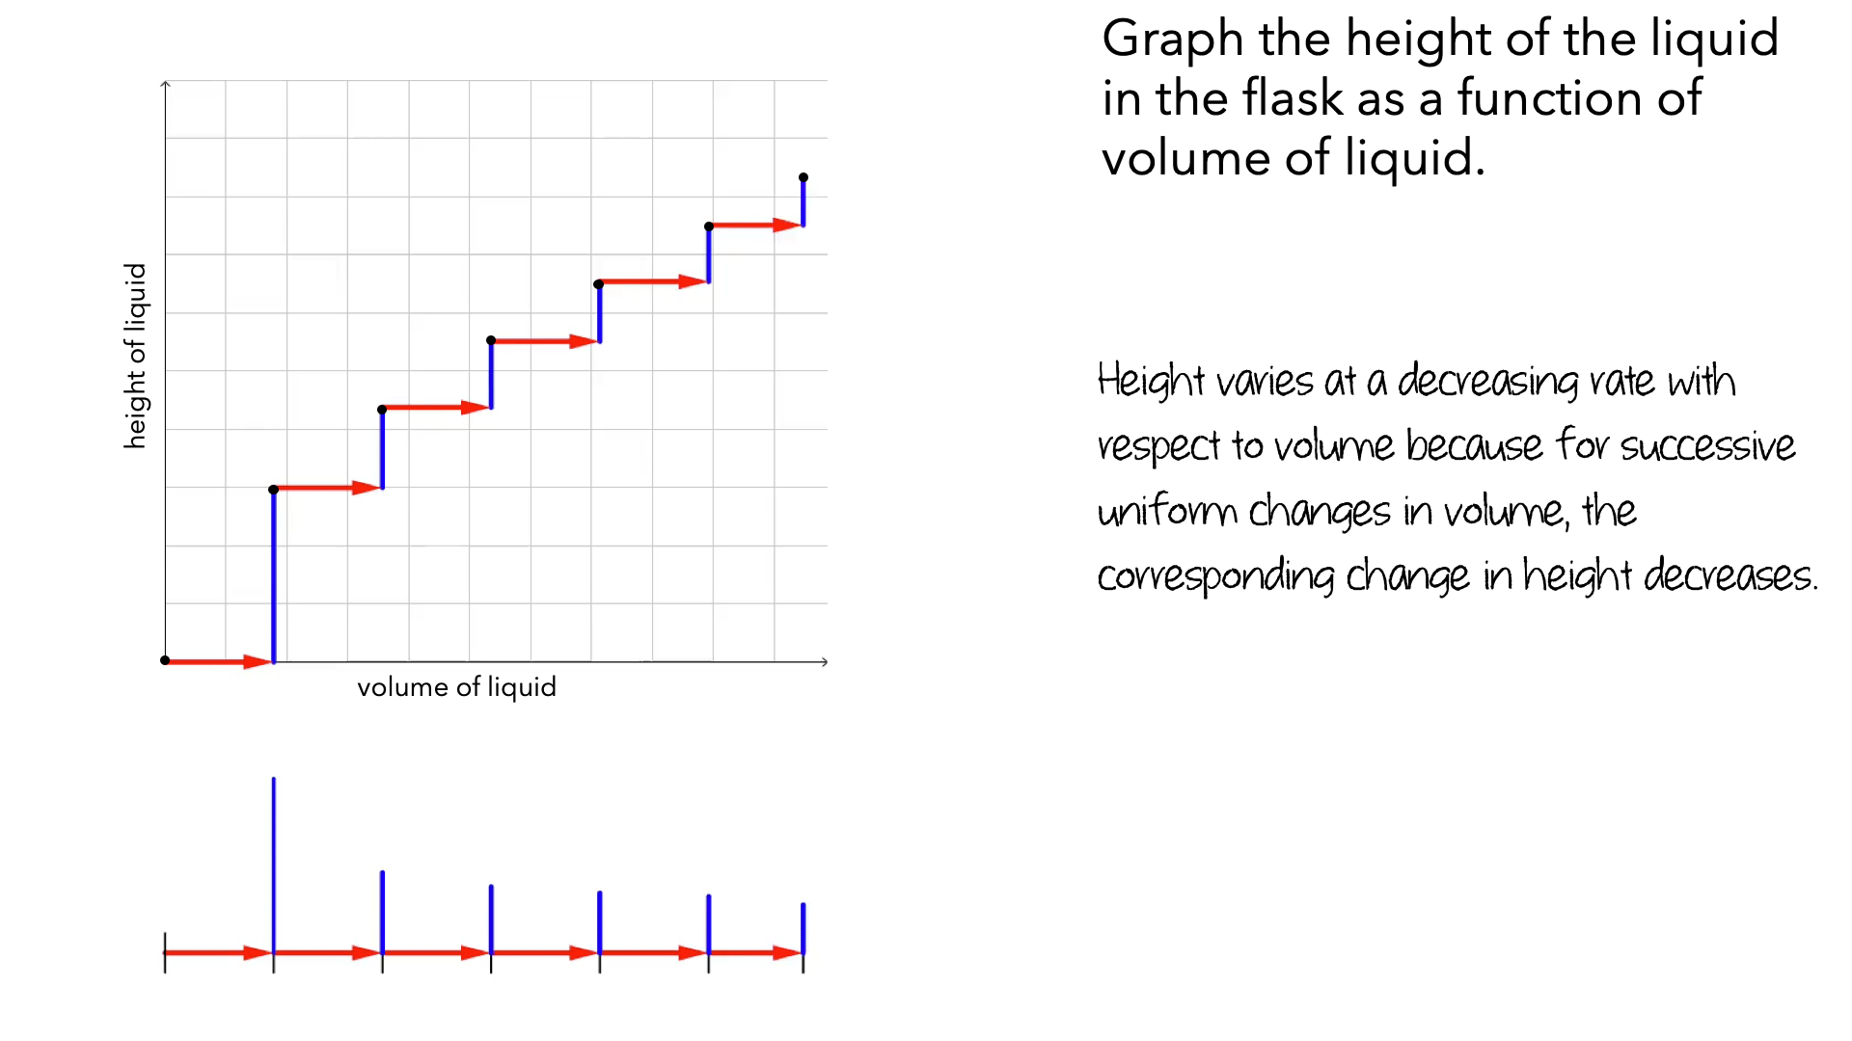
Representations of Measurable Attributes
Notes:
5 minutes

Slide 34
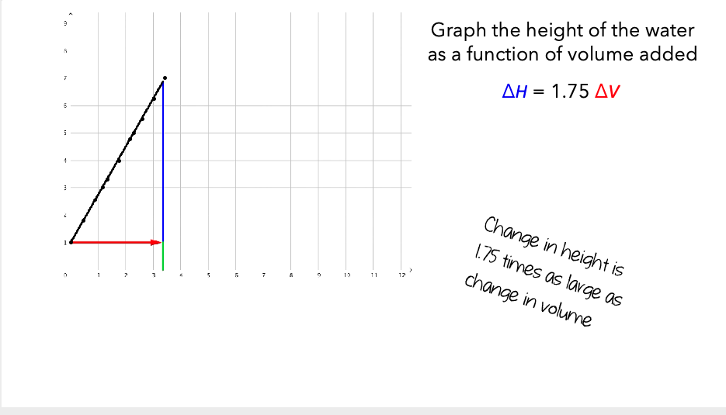
Representations of Measurable Attributes
Notes:
5 minutes

Slide 35
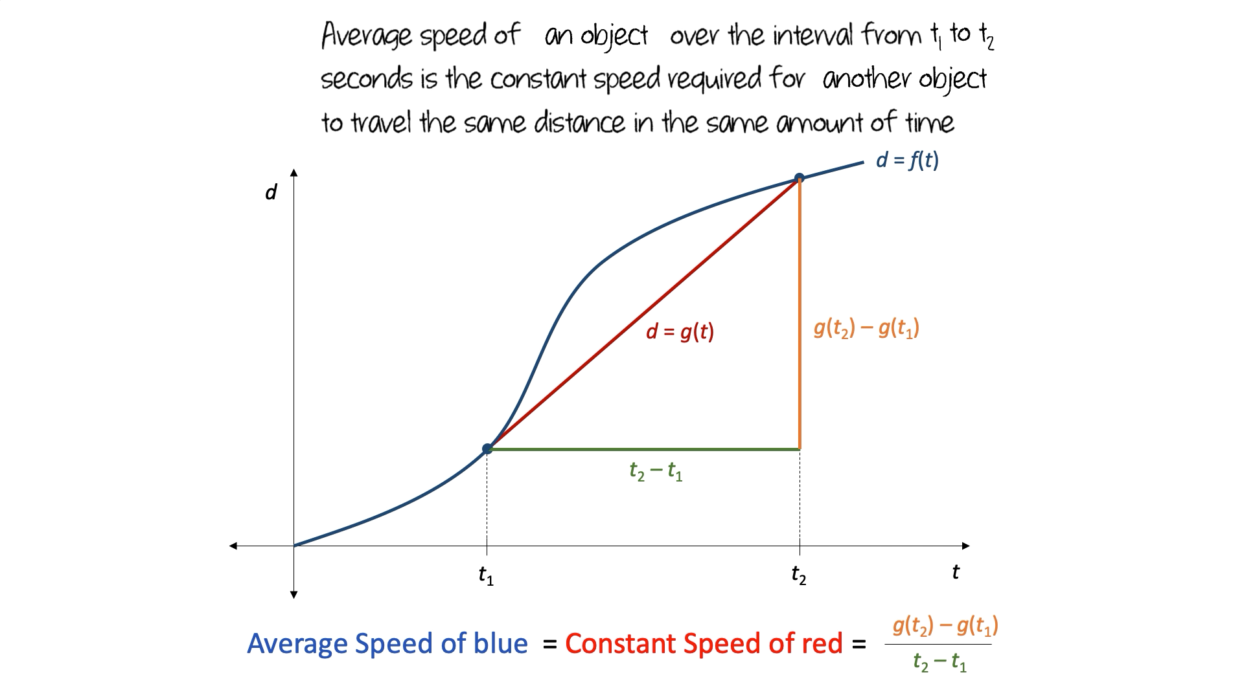
Representations of Measurable Attributes
Notes:
5 minutes

Slide 36
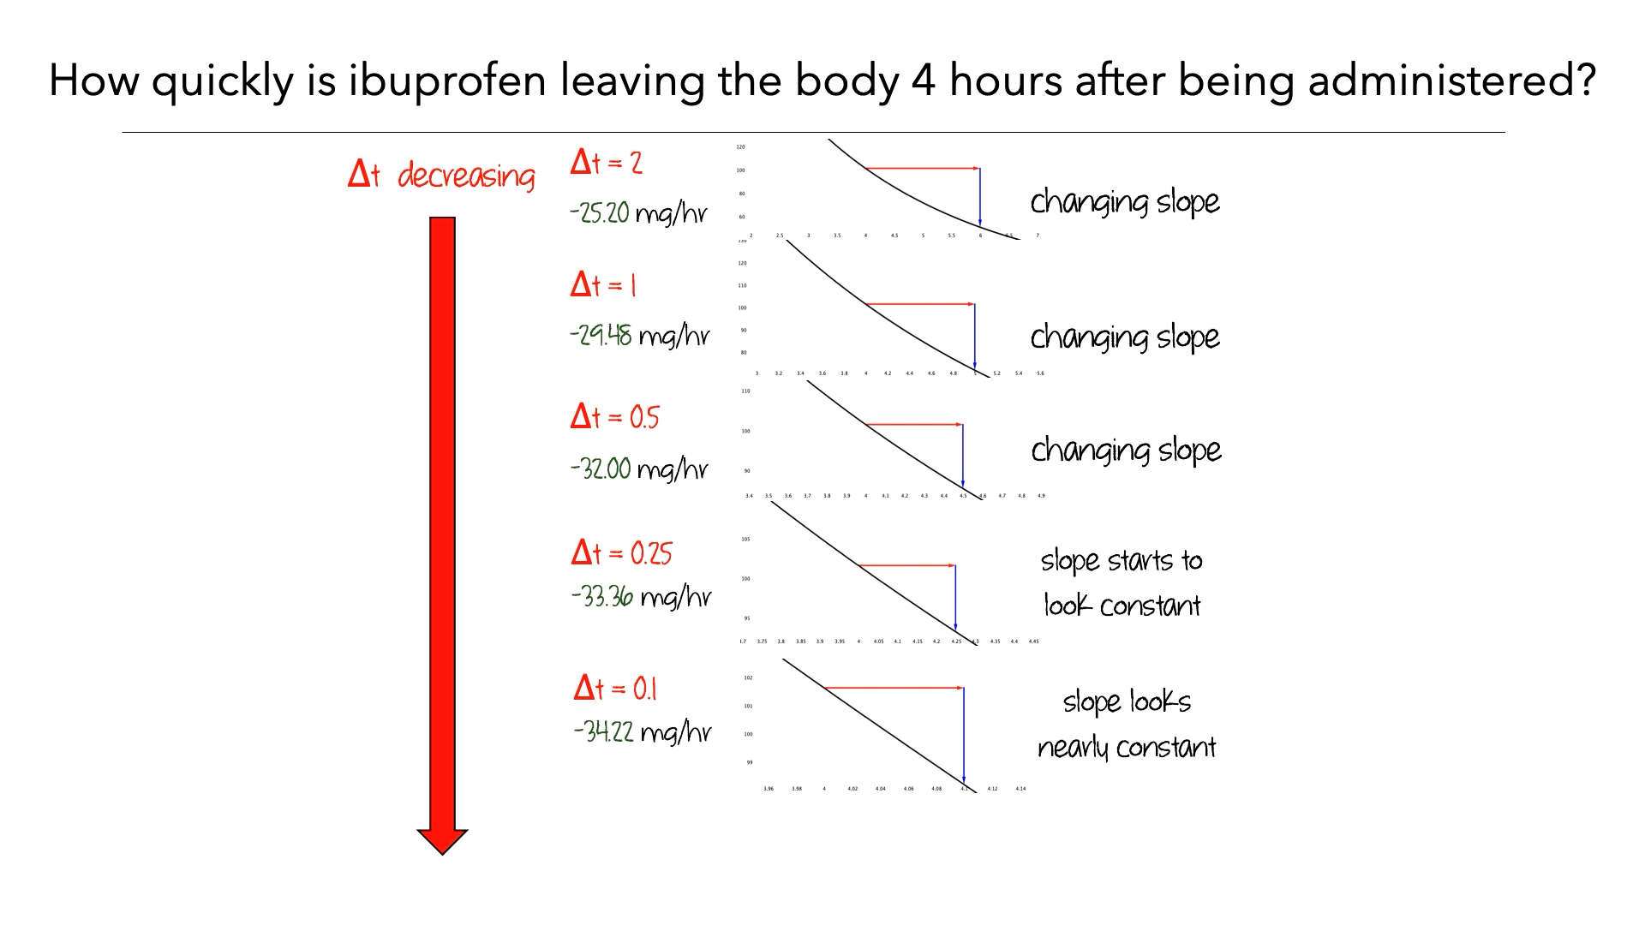
Representations of Measurable Attributes
Notes:
5 minutes

Slide 37
Break
Notes:
10 minutes

Slide 38
Informing Video Design: Quantitative Reasoning
To model mathematical phenomena, a student must first conceive of relevant measurable attributes (quantities) of the phenomena, relate these attributes to one another, and operate on these attributes (quantitative reasoning).
Smith & Thompson, (2007); Thompson, (1990, 2011)
Notes:
Quantitative reasoning is a characterization of the mental actions involved in conceptualizing situations in terms of quantities and quantitative relationships.
1 minute

Slide 39
Mathematical Design Principles: Quantitative Reasoning
Our contextual videos
Prompt students to identify and coordinate measurable attributes (i.e., quantities) as they covary
Represent the relationship between covarying quantities symbolically, graphically, and numerically
Attend to frames of reference and units of measure
Emphasize quantitative (as opposed to arithmetic) operations
Notes:
Read through. Relate back to what they saw in the Pouring Water Video.
2 minutes

Slide 40
Video Sets: CROC to Definition of Limit
CROC & Graphing CROC
Varying Rates of Change & Graphing Varying Rates
Average Rate of Change (AROC): Define AROC in terms of CROC
Approximating Instantaneous Rates of Change: Using AROC over small interval
Limit Definition: Limit over shrinking interval to connect CROC with IROC
Notes:
We’ve already stated that CROC can be used as a foundation of ideas related to the derivative. Here are our video sets.
1 minute

Slide 41
Pick a Video Set & Pick a Video
CROC & Graphing CROC
Varying Rates of Change & Graphing Varying Rates
Average Rate of Change (AROC): Define AROC in terms of CROC
Approximating Instantaneous Rates of Change: Using AROC over small interval
Limit Definition: Limit over shrinking interval to connect CROC with IROC
Notes:
Instructors are to pick a video from a video set. Once everyone has picked, then move to the next slide. Tell them to go to calcvids.org/videos for the youtube links
If time: Each group watches two; encourage one “early” and one “late” video
3 minutes

Slide 42
While You Watch
Be prepared to report back about:
How you see the design principles showing up the video?
How are quantitative and covariational reasoning supported by the imagery in the video?
How the content of the video you selected coheres with the meanings developed in earlier video sets, namely constant and average rates of change.
Notes:
Point out what they should be doing while they watch.
8 minutes to watch video
10 minutes total

Slide 43
Reporting Out
How you see the design principles showing up in the video?
How are quantitative and covariational reasoning supported by imagery in the video?
How the content of the video you selected coheres with the meanings developed in earlier video sets, namely constant and average rates of change.
Notes:
Point out what they should be doing while they watch. Design principles are summarized on the next slide.
10 minutes

Slide 44
Reporting Out: Mathematical Design Principles
Quantitative Reasoning
Prompt students to identify and coordinate quantities as they covary
Represent the relationship between covarying quantities symbolically, graphically, and numerically
Attend to frames of reference and units of measure
Emphasize quantitative (as opposed to arithmetic) operations
Notes:
Questions on previous slide:
How you see the design principles showing up the video?
How are quantitative and covariational reasoning supported by imagery in the video?
How the content of the video you selected coheres with the meanings developed in earlier video sets, namely constant and average rates of change.

Slide 45
Thoughts? Questions? Comments?
Anything we should know before Part 2 to help us better meet your needs?
Notes:
1 - 10 minutes?

Slide 46
End of Part 1

Slide 47
Calculus Videos Project
Calcvids.org
This material is based upon work supported by the National Science Foundation under Awards DUE # 1712312, DUE # 1711837 and DUE # 1710377
Notes:
On screen while instructors are joining.

Slide 48
Session 2 (134 minutes)
Introduction to Another Video Sequence 50 minutes
Riemann sums to FTOC
Demonstrate a Procedural Video 12 minutes
Demonstrate an Intellectual Need Video 28 minutes
Getting Started Using our Video Platform 10 minutes
Ximera
Data Collection 9 minutes
During Semester Supports 5 minutes
Questions? 10 minutes
Notes:
This slide is just meant to provide the instructors an outline of what will be happening during Session 2.
1-minute

Slide 49
Part 2
Introduction to Another Video Sequence
Riemann sums to FTOC
Demonstrate a Procedural Video
Demonstrate an Intellectual Need Video
Getting Started Using our Video Platform
Ximera
Data Collection
During Semester Supports
Questions?
Notes:
This slide is just meant to provide the instructors an outline of what will be happening during Session 2.
1-minute

Slide 50
Overview of CVP Videos for Calculus 1
~30 video sets
Three sequences
Rate of Change to Limit Def. of Derivative
Potpourri
Riemann Sums to FTOC
https://calcvids.org/vids/
Notes:
Meant as a quick reminder of our videos.
1 minute

Slide 51
Overview of CVP Videos for Calculus 1
~30 video sets
Three sequences
Rate of Change to Limit Def. of Derivative
Potpourri
Riemann Sums to FTOC
https://calcvids.org/vids/
Notes:
Meant as a quick reminder of our videos.
1 minute

Slide 52
Mathematical Design Principles
Quantitative Reasoning
Prompt students to identify and coordinate quantities as they covary
Represent the relationship between covarying quantities symbolically, graphically, and numerically
Attend to frames of reference and units of measure
Emphasize quantitative (as opposed to arithmetic) operations
Notes:
This slide is revisited just to remind instructors of our design principles.
Place emphasis on merely QR and CR.
1 minute

Slide 53
Riemann Sums to FTOC Conceptual Development
Computing accumulation when rate is non-constant
Riemann Sums
Are not (defined as) “area under the curve”
Are approximations of accumulation of a quantity over an interval of another quantities’ variation
Definite integrals are exact accumulation of quantities
Notes:
Computing the accumulation of quantity A is difficult when the rate at which it changes (with respect to quantity B) is non-constant. We resolve the issue by assuming the rate at which quantity A varies with respect to quantity B is **constant** over successive uniform intervals of quantity B’s variation.
A Riemann Sum (i.e., a sum of products of a constant rates of change of quantity A with respect to quantity B and the length of the interval over which we assume this constant rate of change)) is an approximation of the accumulation of quantity A over an interval of quantity B’s variation.
Definite integrals represent the exact accumulation of quantity A over an interval of quantity B’s variation (determined by the limits of integration). This exact accumulation is the change in the function values of any antiderivative of function that represents the rate at which quantity A varies with respect to quantity B.

Slide 54
Riemann Sums to Fundamental Theorem
In what ways does this animation demonstrate these ideas?
Assume rate is constant over successive uniform intervals of the independent quantity’s variation.
Leverage constant rate of change over these intervals
Δf ≈ f’(a) Δx.
Total accumulation is approximated by the sum of accumulations over these intervals.
Notes:
Before playing video: PLAY VIDEO TWICE
Go over the bullets,
1st Bullet:
Rate of one quantity (dependent quantity?) with respect to an another quantity (independent quantity).
We choose to keep intervals uniform for simplicity.
You can get to a formal definition of definite integral with uniform intervals.
The overall complexity of Riemann sums is very challenging for students, why make it more challenging?
Δf ≈ f’(a) Δx likely should be read as “The amount of change of the dependent quantity is approximately f’(a) times as much as the amount of change of the independent quantity.”
Tell them,
They are going to see two graphs.
First pay attention to the graph on the left.
We will play a second time.
On the second time, pay attention to the graph on the right.
After video plays: ADVANCE TO NEXT SLIDE
Up to 5 minutes?

Slide 55
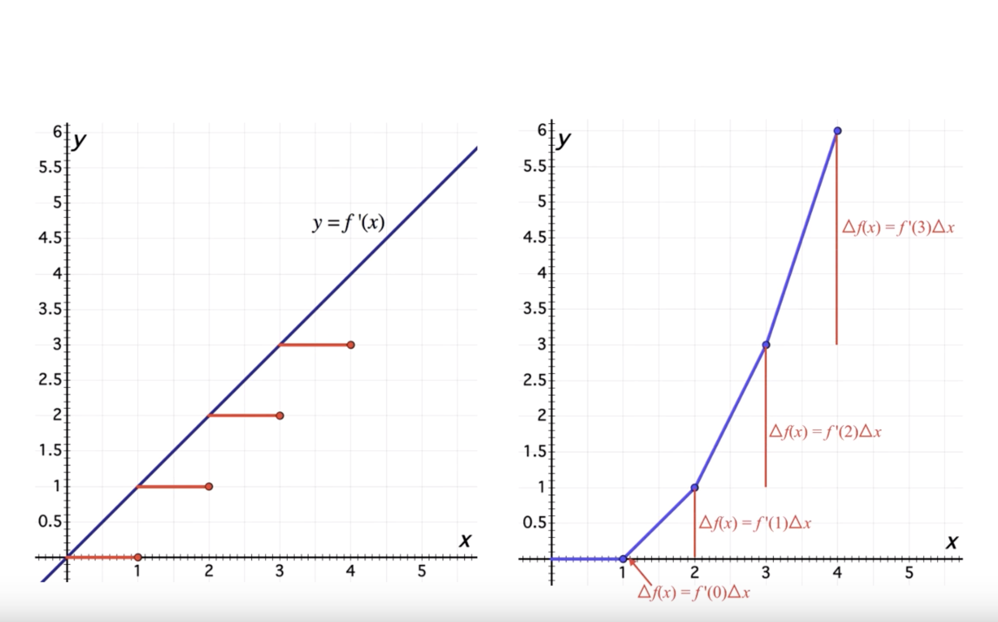
Riemann Sums to Fundamental Theorem
In what ways does this animation demonstrate these ideas?
Assume rate is constant over successive uniform intervals of the independent quantity’s variation.
Leverage constant rate of change over these intervals
Δf ≈ f’(a) Δx.
Total accumulation is approximated by the sum of accumulations over these intervals.
Notes:
After video plays: Discussion: Pay close attention to their language.
What about each graph conveys constant rates
They may note that the graph on the right is potentially a very bad approximation to f (hence, bad approximation to total accumulation).
The graph on the right is NOT f. What is advantageous by NOT showing f?
Focuses students’ attention to the representations of accumulation.
They should think of the graph on the right as an approximation to an antiderivative of the graph on the left.
Where is f’(a) delta x on BOTH graphs? (i.e., where is the Riemann sum?)
They might notice they are not getting the standard Riemann sum graph but that will come in other videos.
The next video will show total accumulation better.
Up to 5 minutes?

Slide 56
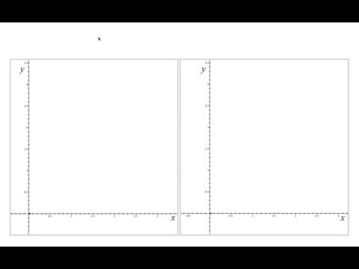
Riemann Sums to Fundamental Theorem
In what ways does this animation demonstrate these ideas?
Total accumulation is approximated by the sum of accumulations over these intervals.
Smaller intervals over which rate is assumed constant can yield better approximations to total accumulation.
The exact total accumulation is the change in the values of an antiderivative.
Notes:
Before playing video: PLAY VIDEO TWICE
Go over the bullets,
The video you are about to see better illustrates the total accumulation.
The video will use smaller intervals.
Tell them,
They are going to see two graphs.
Observe how these graphs differ from what they just saw.
Think about how they are illustrating our concepts.
After video plays: ADVANCE TO NEXT SLIDE
Up to 5 minutes?

Slide 57
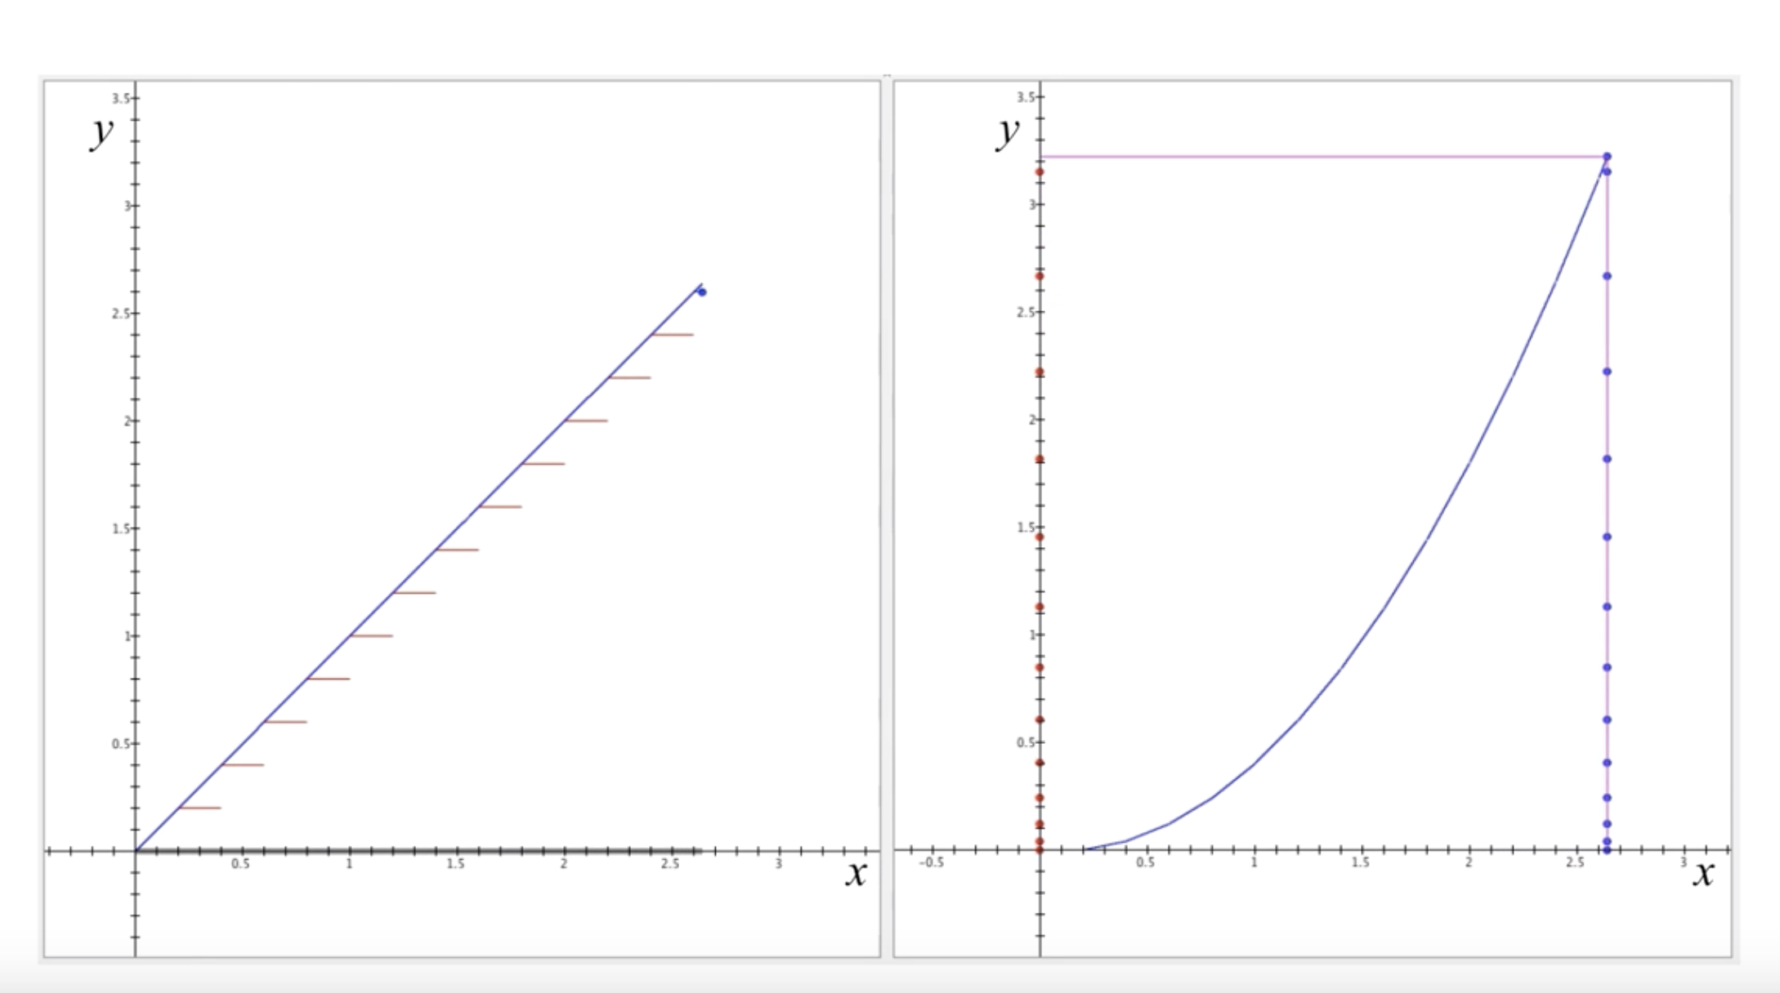
Riemann Sums to Fundamental Theorem
In what ways does this animation demonstrate these ideas?
Total accumulation is approximated by the sum of accumulations over these intervals.
Smaller intervals over which rate is assumed constant can yield better approximations to total accumulation.
The exact total accumulation is the change in the values of an antiderivative.
Notes:
After video plays: Discussion: Pay close attention to their language.
They should think about the graph on the right as (a close approximation to) an antiderivative for the graph on the left.
What about the graph on the right convey’s total accumulation? The total length of the vertical line with would be F(b)-F(a).
They may note that the graph on the right can potentially still be a bad approximation f. Although this is true, in general it is a better approximation, and you can imagine making it a better approximation.
Up to 5 minutes?

Slide 58
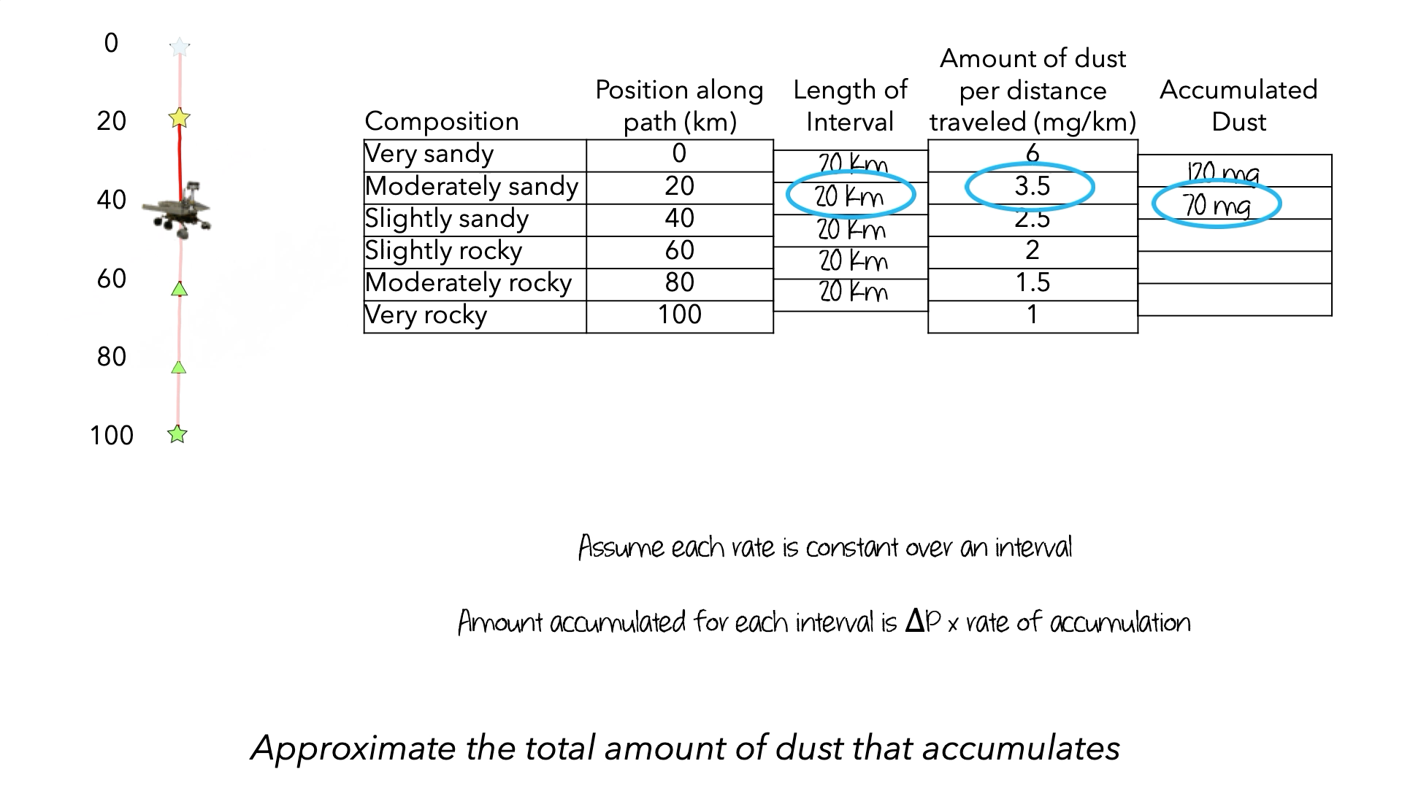
Video: Riemann Sum
What did you notice?
Questions?
Discuss:
Accumulation
Constant rate of change
How they’re represented
How they’re related
To each other
To other concepts & representations
Notes:
To illustrate what we were talking about on the previous slide we are going to show the introduction to Riemann Sums video.
Consider adding detail to better situate the instructor.
2 minutes

Slide 59
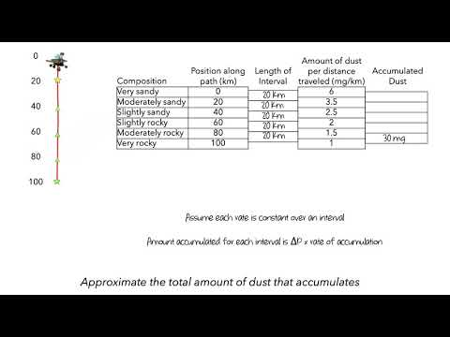

Slide 60
Video: Riemann Sum Discussion
What did you notice about the video?
How do you see the design principles showing up the clip?
How might the video support quantitative reasoning?
Notes:
Have instructors report out.
Takes notes on what the instructors report.
After a brief discussion, comment on what that reported that we are going to talk about later.
Address any immediate concerns.
5-8 minutes

Slide 61
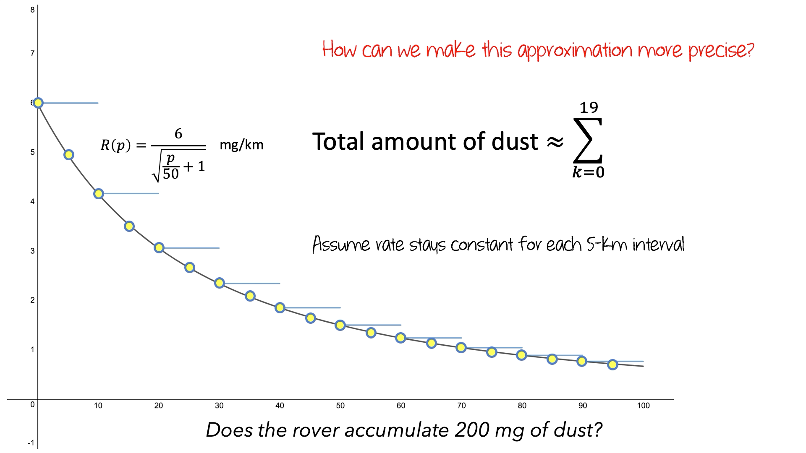
Video: Definite Integral
What did you notice?
Questions?
Discuss:
Accumulation
Constant rate of change
Riemann Sums
How they’re represented
How they’re related
To each other
To other concepts & representations
Notes:
Now to definite integral.
Consider adding detail to better situate the instructor.
2 minutes

Slide 62
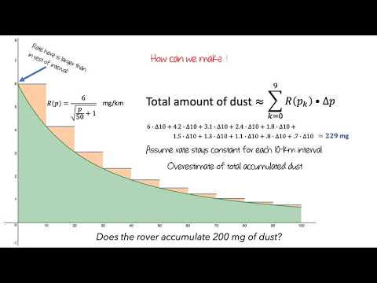
Notes:
1-2 minute clip?

Slide 63
Video: Definite Integral Discussion
What did you notice about the video?
How do you see the design principles showing up the clip?
How are quantitative and covariational reasoning supported by the clip?
How does this clip align with the previous clip?
Notes:
Have instructors report out.
Takes notes on what the instructors report.
After a brief discussion, comment on what that reported that we are going to talk about later.
Address any immediate concerns.
5-8 minutes

Slide 64
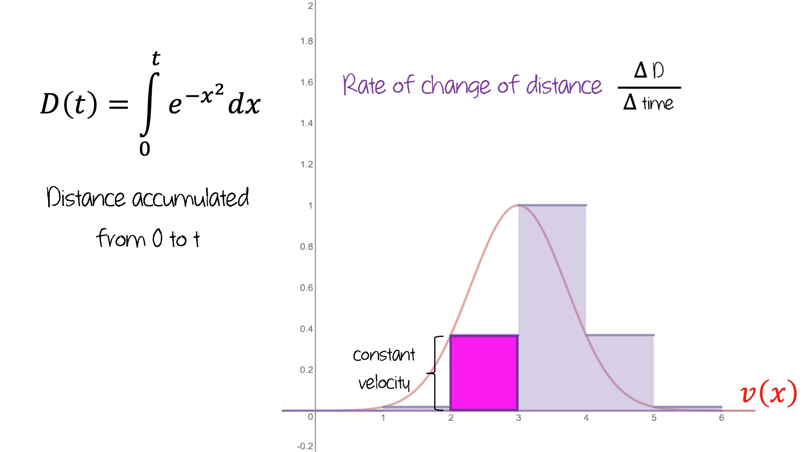
Video Clip: FTOC
What did you notice?
Questions?
Discuss:
Accumulation
Constant rate of change
Riemann Sums
Definite Integrals
How they’re represented
How they’re related
To each other
To other concepts & representations
Notes:
Now to the Fundamental Theorem of Calculus.
Consider adding detail to better situate the instructor.
1 minutes

Slide 65
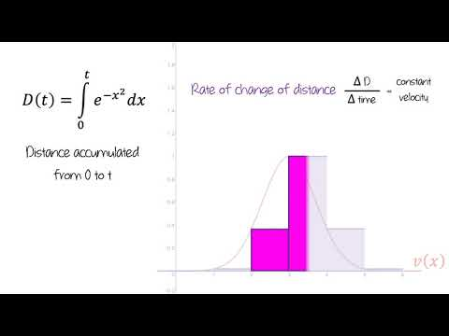
Notes:
1-2 minute clip?
This is video 2 - matches the screenshot

Slide 66
Video Clip: FTOC Discussion
What did you notice about the clip?
How do you see the design principles showing up the clip?
How are quantitative and covariational reasoning supported by the clip?
How does this clip cohere with the previous clip?
Notes:
Have instructors report out.
Takes notes on what the instructors report.
After a brief discussion, comment on what that reported that we are going to talk about later.
Address any immediate concerns.
5-8 minutes

Slide 67
Riemann Sums to Fundamental Theorem
Questions?
Notes:
Consider repeating a previous slide. This time, ask for any question about this “chunk”
Up to 5 minutes

Slide 68
Break
Notes:
10 minute break

Slide 69
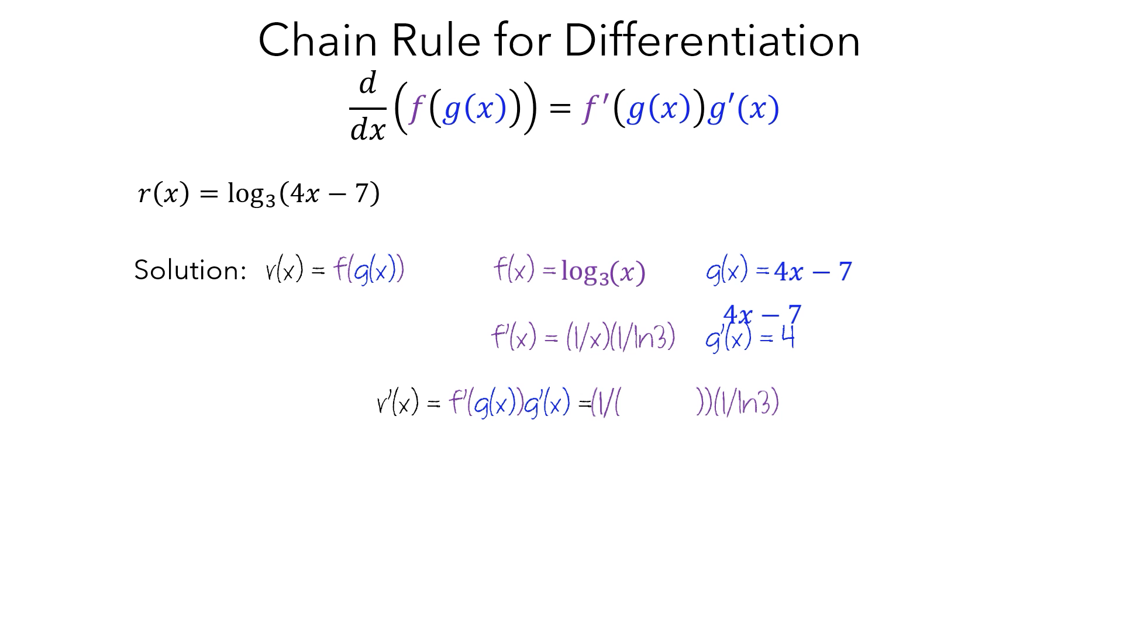
CVP Procedural Videos
How does visual design relate to and/or support the ideas?
Notes:
We’ve been focusing on our contextual videos, the type of reasoning we desire to promote and how we bring coherence across multiple concepts by highlighting shared meanings using shared representations. We have yet to really demonstrate a more procedural video. Now we are going to show a long clip from one of our procedural videos.
2 minutes

Slide 70
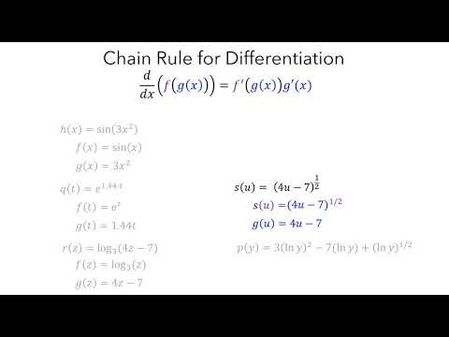
Notes:
2 minute clip?

Slide 71
CVP Procedural Videos Discussion
What did you notice about the video?
How do you see the design principles showing up the clip?
Notes:
Have instructors respond to the questions. Take notes and highlight our design choices.
8 minutes

Slide 72

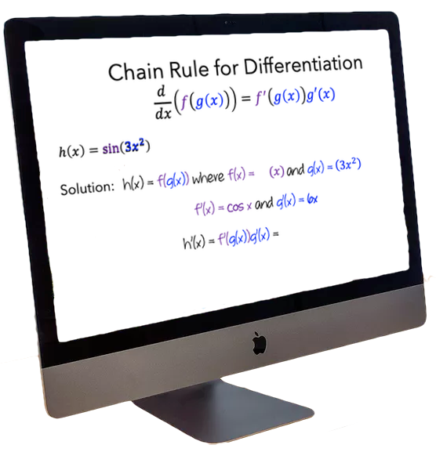

Intellectual Need
I already understand the chain rule, and why it’s important.
She doesn’t.
Notes:
When we began interviewing students as they watched the videos, we noticed that they didn’t appear to pay much attention. Many students appeared to feel that they already understood the concepts—even after they struggled to answer the post-video questions.
As a way to encourage students, we have attempted to incorporate the idea of intellectual need into the video-watching structure.
So, what is intellectual need?

Slide 73
Intellectual Need Tasks
Use a factor tree to find the prime factorization for each of the following:¹
504
2475
11,250
Given that 1750=2•5•5•5•7, find all the factors of 1750²
From Billstein, R., Libeskind, S., & Lott, J. W. (2007) A Problem Solving Approach to Mathematics for Elementary School Teachers (9th ed.). Boston: Pearson.
From Lim, K. H. (2009). Provoking intellectual need. Mathematics Teaching in the Middle School, 15(2), 92-99.
Notes:
Here are two tasks that were intended to help students learn about the concept of prime factorization.
Take a moment to read through these two tasks.
Although students may appreciate the usefulness of prime factorization for the sake of listing all the factors of a number, the need to express a number as a product of primes is not intrinsic for them, especially when they can find all the factors of a number by checking each prime number through division.

Slide 74
Intellectual Need Tasks
3. Consider these four products of numbers:
5²•6•11⁸⁷•96
3•11⁸⁵•25•44²
11⁸⁶•12²•20•55
10²•11⁸⁴•22²•33
4. Identify those products that have the same value³
3. Task from Lim, K. H. (2009). Provoking intellectual need. Mathematics Teaching in the Middle School, 15(2), 92-99.
Notes:
Here is another task - take a moment to read through it.
In what ways does this task appear similar to and different from the previous tasks?
This task provides students an opportunity to experience the efficiency of using prime factorization as a means to compare products of numbers without actually computing each product. Using their existing knowledge, students may come up with different ways to solve the problem. However, strategies such as computing the product and guessing various compositions and decompositions would be tedious, and students would likely appreciate the directedness of expressing each product as a product of primes to compare values, leading them to realize the power of the uniqueness of prime factorization.

Slide 75
Theory of Intellectual Need⁴
An internal drive experienced by a learner to solve a problem
Students are most likely to learn when they see an intellectual need (rather than a social or economic need) for what we intend to teach them.
“When students encounter a problematic situation because of the limitation of their existing knowledge, they will most likely experience an internal desire to resolve the situation; the resolution may lead to modification of their existing knowledge or construction of new knowledge.”
4. Adapted from Lim, K. H. (2009). Provoking intellectual need. Mathematics Teaching in the Middle School, 15(2), 92-99.
Notes:
The difference between these tasks is related to the idea of intellectual need, which is an internal drive experienced by a learner to solve a problem.
Guershon Harel proposed that students are most likely to learn when they see an intellectual need (rather than a social or economic need) for what we intend to teach them.
In order for this to occur, they need to encounter a problem that feels intrinsic to them. Lim writes: “When students encounter a problematic situation because of the limitation of their existing knowledge, they will most likely experience an internal desire to resolve the situation; the resolution may lead to modification of their existing knowledge or construction of new knowledge.”
Our goal was to create tasks that would provoke intellectual need—that is, completing the task would require the student to understand the target concept.

Slide 76
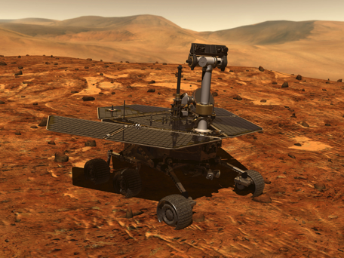
Designing Intellectual Need Tasks
The Opportunity rover is powered by solar cells. As it travels across the Martian surface, it kicks up dust, which accumulates on its solar cells. The amount of dust that it kicks up depended on the composition of the surface it was traveling over. Scientists have mapped out a 100-km path for the rover to follow and have collected satellite data about the composition of the Martian surface at various points along the route.
Based on the table, approximate the amount of dust accumulated
on the rover’s solar panels:
16.5 mg
15.5 mg
10.5 mg
310 mg
210 mg
330 mg
Other
Composition | Position along path (km) | Amount of dust per distance traveled (mg/km)
Very sandy | 0 | 6
Moderately sandy | 20 | 3.5
Slightly sandy | 40 | 2.5
Slightly rocky | 60 | 2
Moderately rocky | 80 | 1.5
Very rocky | 100 | 1
Notes:
For example, here is the intellectual need task we designed for the concept of Riemann sums. Take a minute to read through it.
The task is different from the context. Students may or may not find the context of a mars rover compelling. But the task of computing a total amount of a quantity that accumulates is, we think, one that necessitates the concept of a Riemann sum - that is, Riemann sum is the tool that lets us complete the task.
We have another issue, though - what if a student erroneously thinks they already know how to complete this task? Or what if they just don’t think about it in much detail? To address this issue, we created videos of a pair of calculus students working on the task. In each of these videos, the students demonstrate multiple reasonable ways of thinking about the problem; in some cases, they don’t reach a conclusion, and in others they reach a conclusion but express some skepticism about its accuracy.

Slide 77
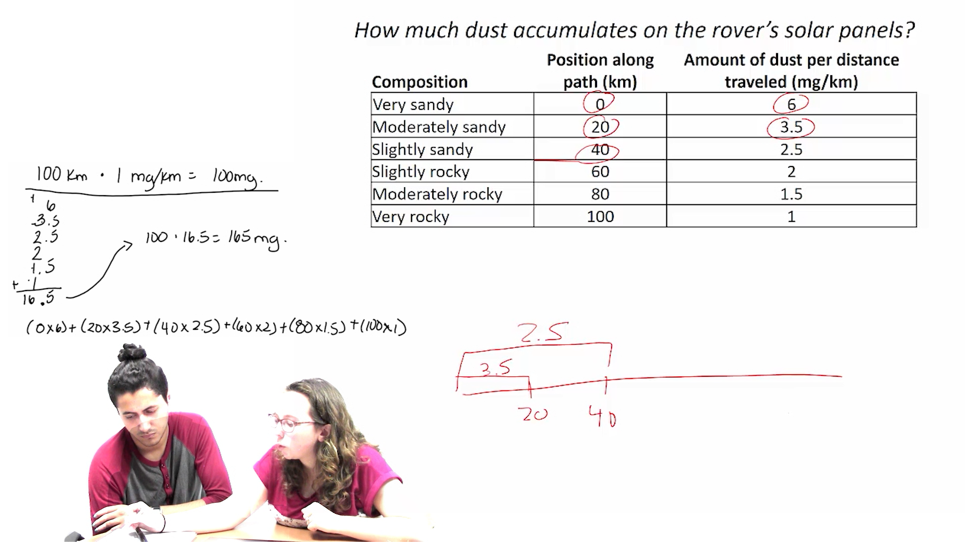
CVP Intellectual Need Videos
What is the task?
What concept(s) are needed for completing the task?
How does students’ activity demonstrate and/or provoke intellectual need?
Notes:
To illustrate what we were talking about on the previous slide we are going to show an intellectual need video.
Take a moment to describe what they are about to see. Emphasize how the students in the video will not come to a resolution.
3 minutes

Slide 78
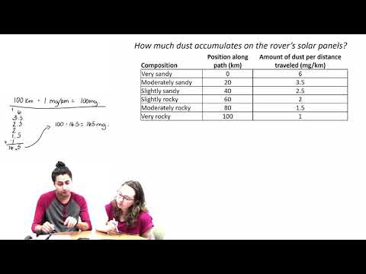
Notes:
5 minute video

Slide 79
CVP Intellectual Need Videos
What is the task?
What concept(s) are needed for completing the task?
How does students’ activity demonstrate and/or provoke intellectual need?
Notes:
Have them report out.
Anticipate several questions.
10 minutes

Slide 80
CVP Intellectual Need Videos
Questions?
Notes:
They likely already asked questions from the previous slide, but just in case.
1-5 minutes

Slide 81
Getting Started: What is Ximera?
A web platform for developing mathematical curricular materials
Developed at Ohio State University
Can be used for online textbooks with interactive pieces such as:
Geogebra applets
Desmos graphs
Videos
Equation or Numerical Input / Multiple Choice / Select All / Free Response Questions (all but Free response provide immediate feedback)
Notes:
Go over each bullet.
1-2 minutes

Slide 82
Go to the Ximera Website and Demonstrate
Link for students:
https://calcvids.org/vids/
Intro:
https://ximera.osu.edu/calcvidstest/intro/intro
Example page:
https://ximera.osu.edu/calcvidstest/in/v/croc
Notes:
The first link is the one students will see - it randomly assigns them to a treatment
Second link is an example of one of the pages that the first page could bring them to
5-8 minutes

Slide 83
Why Do We Use Ximera
Collect data on usage:
Video watching
How students answer questions
Answers on free responses questions
Lets us identify
how the videos are being used
whether types of video usage correspond to learning
Notes:
Go over each bullet.
1-2 minutes

Slide 84
How Do We Use Ximera?
When you load a ximera page, you see one of 6 variations of the website
Note: Your students may ask questions about why they saw a different version than their friends
3 treatments - before seeing the video set, you see one of:
Outline of Video
Introductory video featuring students working on a task
Control
Each treatment might (or might not) include a “intellectual need task”
This is randomized per video set, so you will see different versions on different video sets
The choice is stored as a cookie on the computer, so you will be directed to that version if you reload the page later on the same computer
Notes:
Go over each bullet.
1-2 minutes

Slide 85
Information For Your Students
Ximera Introduction - Beginning of semester survey/page
https://ximera.osu.edu/calcvidstest/intro/intro
What giving consent to use data means
How to access Ximera pages
https://calcvids.org/vids
End of semester survey
https://ximera.osu.edu/calcvidstest/survey/survey/survey

Slide 86
Ximera Questions?
Notes:
1-5 minutes?

Slide 87
Final Thoughts? Questions? Comments?
Notes:
1 - 10 minutes

Slide 88
During Semester Supports
1-week, ⅓ and ⅔ point in semester (optional) Zoom meetings?
Contact project members any time
Ximera-specific - Matt (mthomas7@ithaca.edu)
Anything else - Aaron (aweinberg@ithaca.edu)
Theory questions - Michael (michael.tallman@okstate.edu)
Animation - Jason (jasonm@uca.edu)
https://groups.google.com/forum/#!forum/calcvids
Notes:
3-5 minutes

Slide 89
Thank You!

